Slide 1

Translation Software

Slide 2
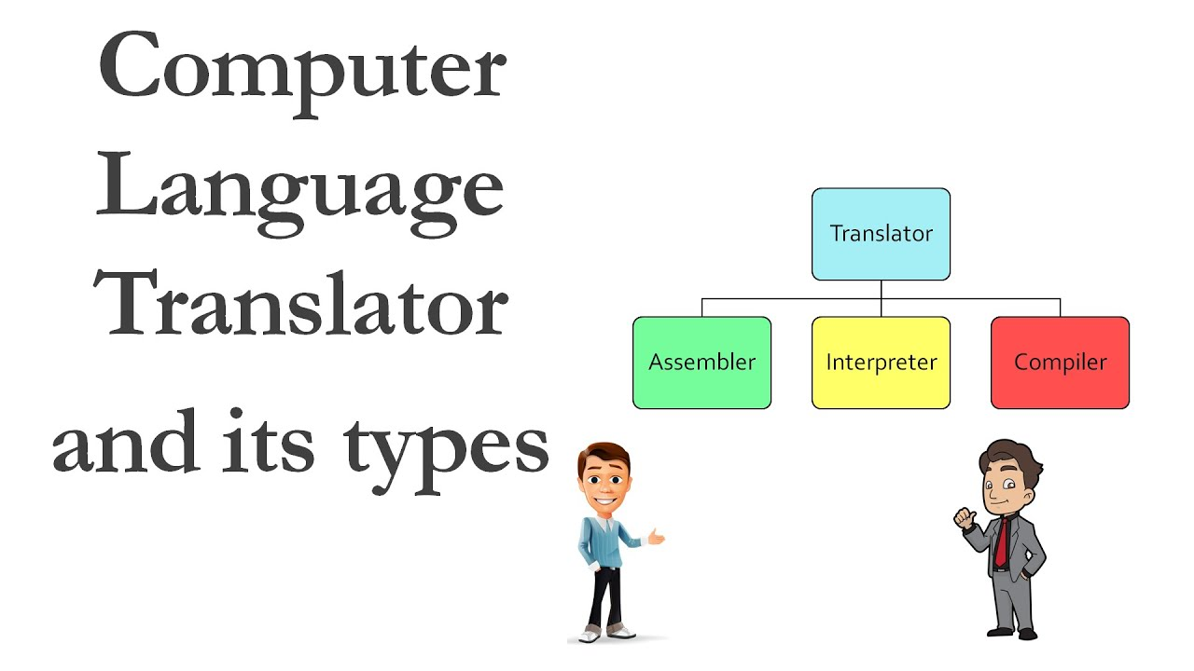
Revision
A translator is a piece of software that converts high-level code (source code) into low-level machine code (object code) that can then be executed by the processor.

Slide 3
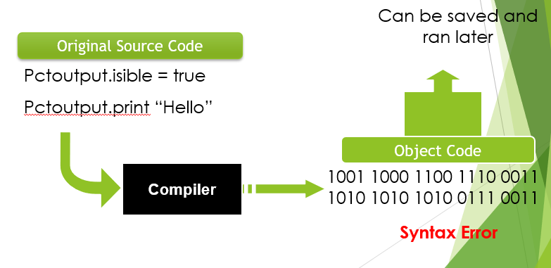
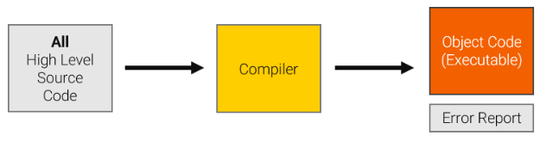
Compiler
A compiler translates an entire program code written in a high level language (HLL) into machine code all in one go
Once a program is compiled the machine code can be used again and again to perform the same task without re-compilation.
If errors are detected, then an error report is produced for the whole code instead of a compiled program.

Slide 4
Compiler
The compiler produces and executable code.
Source code can be protected from being copied.

Slide 5
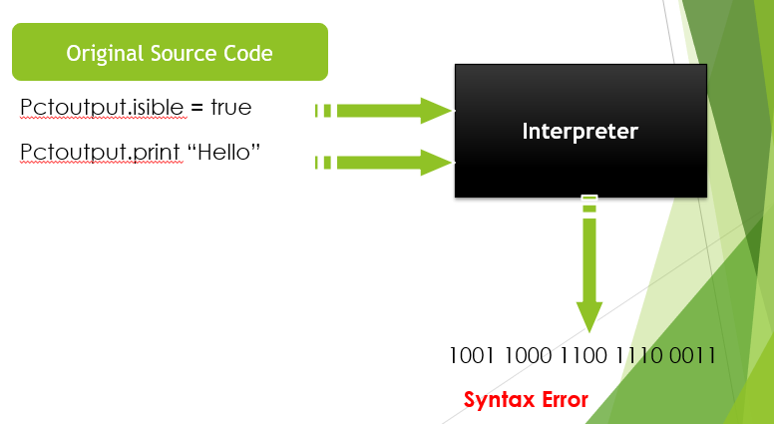
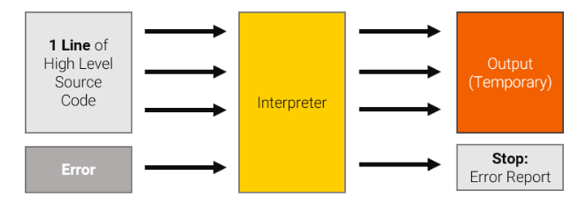
Interpreter
An interpreter translates source code into machine code one instruction at a time.
The resulting machine code is then executed immediately. The process is called interpretation.

Slide 6
Interpreter
Each program line, when run, is firstly syntax-checked. If a syntax error is found, e.g. a missing bracket, the program halts and it is reported.
No executable file is produced and when the program is run again in the future, the interpreter must retranslate every line of code again.

Slide 7
Program Compilation

Slide 8

Objectives
At the end of the lesson students should be able to
State what is meant by program compilation
Give reasons for compiling a program
Identify the stages of programme compilation
Give the purpose of each identified stage
Describe the activities that take place at each stage

Slide 9
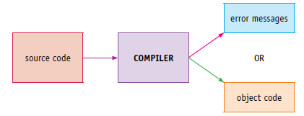
How an interpreter differs from a compiler
An interpreter executes the program it is interpreting.
A compiler does not execute the program it is compiling.
With a compiler the program source code is input and either the object code program or error messages are output.
The object code produced can then be executed without needing recompilation

Slide 10
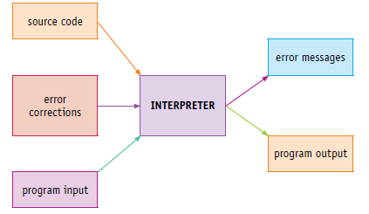
Stages in the compilation process
With an interpreter, the program source code is entered as the compiler but there are other inputs that the program requires or to correct errors in the source program. No object code is output, but error messages from the interpreter are output, as well as any outputs produced by the program being interpreted.
As there is no object code produced from the interpretation process, the interpreter will need to be used every time the program is executed.

Slide 11
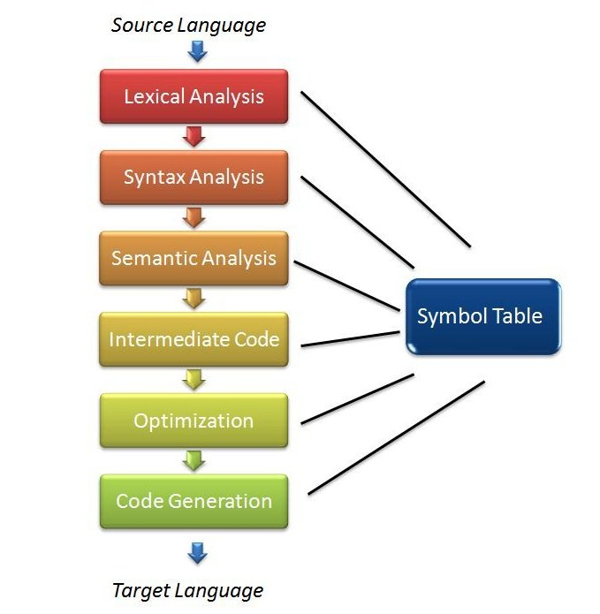
Stages in the compilation process
There are 4 steps in which to produce an object code
Lexical Analysis
Syntax Analysis-Semantic analysis
Code Generation
Code optimization

Slide 12
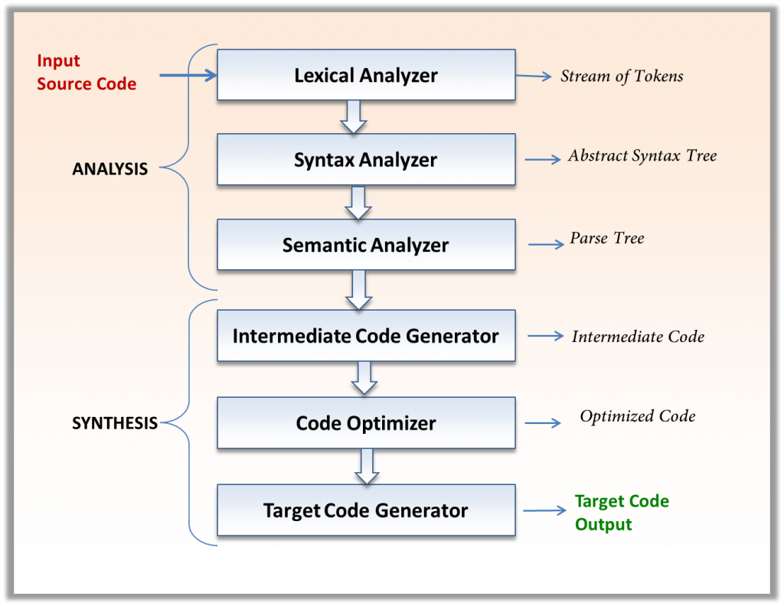
Parts of the compiler
The compiler is designed into two parts.
The first phase is the analysis phase while the second phase is called synthesis.

Slide 13
Lexical Analysis

Slide 14
Lexical Analysis
Lexical Analysis is the first phase of the compiler also known as a scanner
The first part of the lexical analysis operation is the removal of any non-program element
A good program have indent and uses white spaces along with comments. All things that improves the program’s readability such as white spaces, indents and comments are removed. (all these are of benefit to the human reader, they are not executable code)
Next operation of the lexical operation is that it scans by reading the streams of characters making up the source program from left-to-right and group them into tokens
This process is called tokenization.

Slide 15

Lexical Analysis: Tokens
What are tokens?
Each token represents one logical piece of the source file – a keyword, the name of a variable, etc.
Tokens are sequences of characters with a collective meaning. There are usually only a small number of tokens for a programming language:
constants (integer, double, char, string, etc.),
operators (arithmetic, relational, logical),
punctuation
reserved words

Slide 16
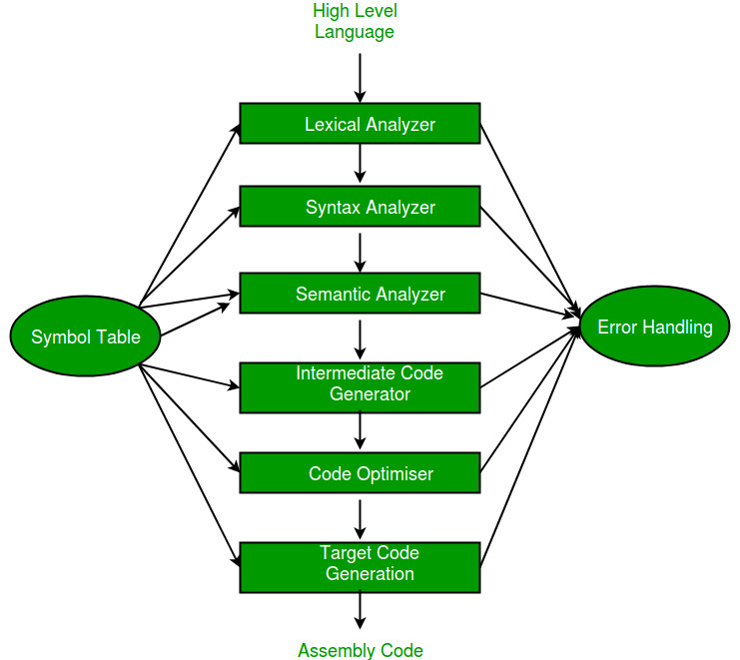
Stages in program Compilation Error handling and symbol table are important part of each stage

Slide 17
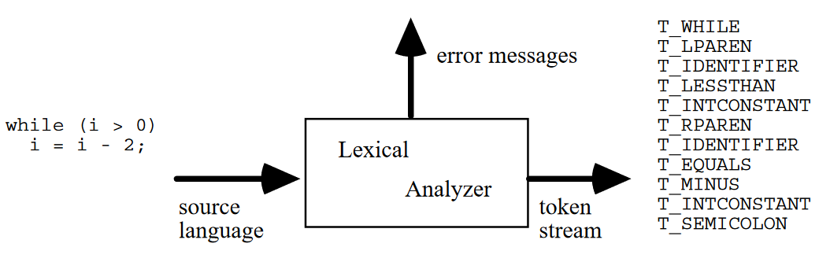
Lexical Analyzer: Token Example
The lexical analyzer might recognize particular, instances of tokens such as:
3 or 255 for an integer constant token
"Fred" or "Wilma" for a string constant token
numTickets or queue for a variable token

Slide 18
Lexeme
A lexeme is the actual character sequence forming a token, the token is the general class that a lexeme belongs to.
Some tokens have exactly one lexeme (e.g., the > character); for others, there are many lexemes (e.g., integer constants).

Slide 19
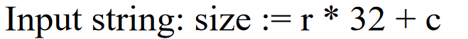
Examples of Token and Lexemes
Token | Lexeme
id | Size
assign | :=
id | r
arith_symbol | *
integer | 32
arith_symbol | +
id | c

Slide 20
Activity Exercise
Create a table to show the token and lexemes for the following codes.
while (y >= t) y = y - 3
{ return x + y ; }

Slide 21
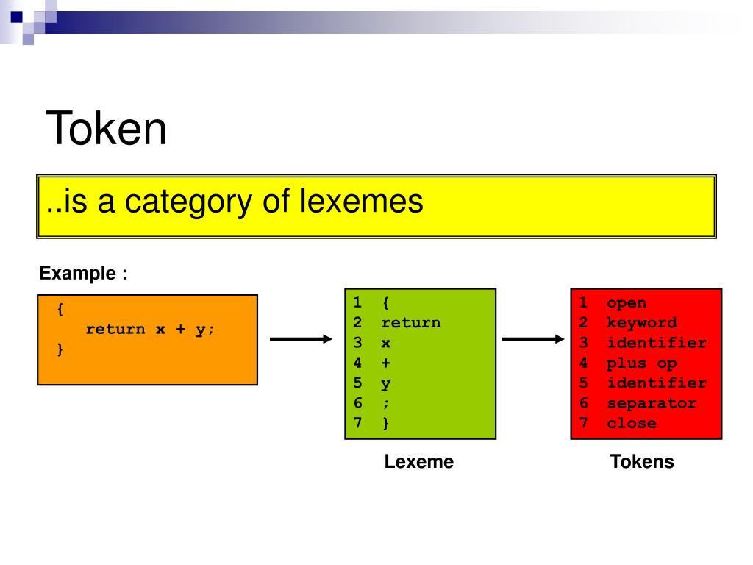
Solution
Lexeme | Token**
while | WHILE
( | LPAREN
y | IDENTIFIER
<= | COMPARISON
t | IDENTIFIER
) | RPAREN
y | IDENTIFIER
= | ASSIGNMENT
y | IDENTIFIER
- | ARITHMETIC
3 | INTEGER
; | SEMICOLON

Slide 22
Lexical Analyser cont.
Next, the lexical analyzer makes an entry of the tickets into the symbol table and then passes that token to next phase.
Important keynote.
The lexical analyser can only divide the input stream into valid symbols but does not know where each token should go.
Very few errors are detected at this stage because the scanner (lexical analyser) has a limited view of the source program without any context. It can only report the characters that are not valid tokens such as an illegal or unrecognized symbol or entities with characters within a string ect
It does not look for or detect wrong sequences, tokens out of place, undeclared identifiers, misspelled keywords, mismatched types ect.

Slide 23
Lexical Analyser Summary
All the comments and whitespace are removed from the program.
High level code is turned into a series of tokens, using reserved words that the computer is able to pick out.
A symbol table is created which stores the names and addresses of all variables, constants
Variables are checked to make sure they have been declared and to determine the data types used
Token is passed to the next stage

Slide 24
Syntax Analyis

Slide 25
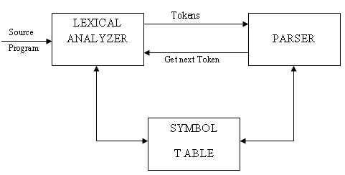
Syntax Analyis
The stage is also known as the parsing.
This stage the syntax analyzer (the Parser)
Checks the syntax of the statements to ensure they conform to the rules of grammar for the computer language in question.
Checks that tokens have been assigned to the code elements
checks that the tokens are in the correct order and follow the rules of the language.
checks each line of the code and spots every tiny mistakes that the programmer has committed while typing the code and suggest possible ways to rectify our errors.
A Parse tree is then created

Slide 26
What is a Parser?
A parser is a compiler or interpreter component that breaks data into smaller elements for easy translation into another language.
A parser takes input in the form of a sequence of tokens,, or and breaks them up into parts that can be used by other components in programming.
A parser usually checks all data provided to ensure it is sufficient to build a data structure in the form of a parse tree or an abstract syntax tree.

Slide 27
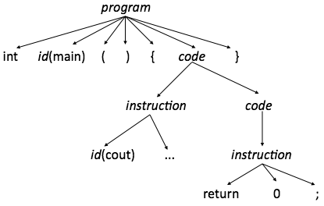
What is a Parse Tree?
A parse tree contains all the tokens that appeared in the program and possibly, a set of intermediate rules
Parse tree is easier to produce for the parser since it is a direct representation of the parsing process.

Slide 28
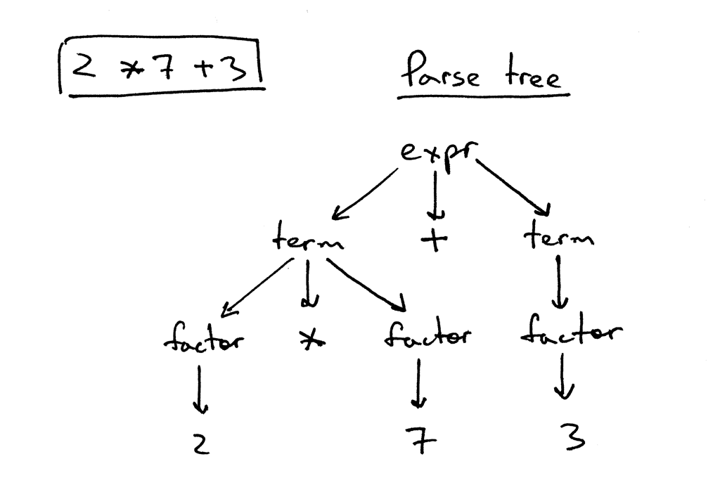
Parse Tree Example
The diagram shows that the parse tree:
records a sequence of rules the parser applies to recognize the input.
The root of the tree is labeled with the grammar start symbol.
Each interior node represents a grammar rule application, like expr, term, or factor in our case.
Each leaf node represents a token

Slide 29
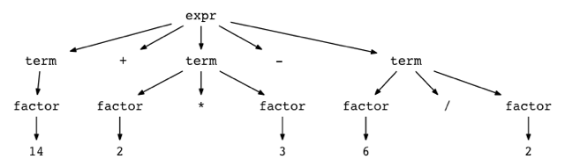
Parse Tree Example
Represent the following expression as a parse tree
14 + 2 * 3 - 6 / 2:

Slide 30
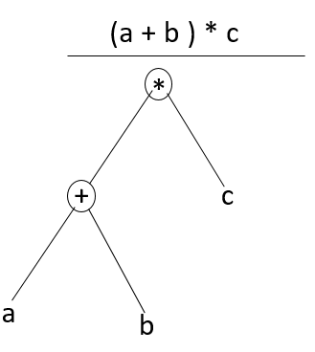
what is an abstract syntax tree? (AST)
The abstract syntax tree (AST) is created during the syntax stage.
This maps the structure of the program, first dropping the brackets, semicolons, etc, that were used by the programmer.
If required tokens are missing from the tree, or in the wrong place, the compiler will report an error.
The AST, instead, is a polished version of the parse tree, in which only the information relevant to understanding the code is maintained

Slide 31
Syntax Analyser Summary
Checks code is written in a valid syntax
Compiles a list of errors for user where code does not follow the languages rules
Produces a parser tree
It produces an abstract syntax tree, which represents the program.

Slide 32
Semantic Analyis

Slide 33
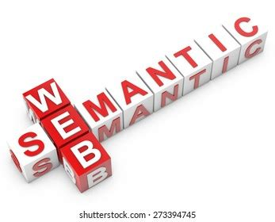
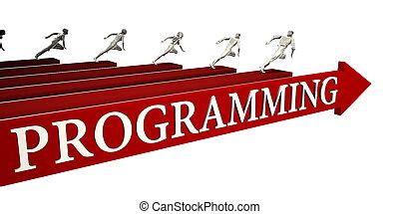
Semantic Analyis
The semantic analyser is mainly concerned with what the program means and how it executes.
It checks
the semantic consistency of the code.
It uses the syntax tree of the previous phase along with the symbol table to verify that the given source code is semantically consistent.
whether the code is conveying an appropriate meaning.
Type mismatches, incompatible operands, a function called with improper arguments, an undeclared variable, etc
Type checking is an important aspect of semantic analysis where each operator should be compatible with its operands.

Slide 34
Semantic Analyis
Summary
Helps you to store type information gathered and save it in symbol table or syntax tree
Perform type checking
In the case of type mismatch, where there are no exact type correction rules which satisfy the desired operation, a semantic error is shown
Collects type information and checks for type compatibility
Variables are checked to make sure they have been correctly declared and contain the correct data type.
Updates to the symbol table

Slide 35
Semantic Analyis
float x = 20.2;
float y = x*30;
In the above code, the semantic analyzer will typecast the integer 30 to float 30.0 before multiplication

Slide 36
Code Generation

Slide 37
Code Generation
A separate program is created that is distinct from the original source code.
The code generated is the object code, which is the binary equivalent of the source code.
This is the executable version of the code, before linked libraries are included.
Code generation is a major distinguishing feature between compilation and interpretation; interpreters do not produce a separate executable file.

Slide 38
Code Optimization
This is an optional phase that improves or optimizes the intermediate code to enable the output to be run faster.
This phase eliminates unnecessary code lines and ensures that the output occupies less space.

Slide 39

Code generation
This is the final stage that transforms the optimized code into the desired machine code.

